Slide 1
The Society of Thoracic Surgeons Adult Cardiac Surgery Database Monthly Webinar
February 5, 2025

Slide 2
Agenda
Welcome and Introductions
STS Updates
New for 2025

Slide 3
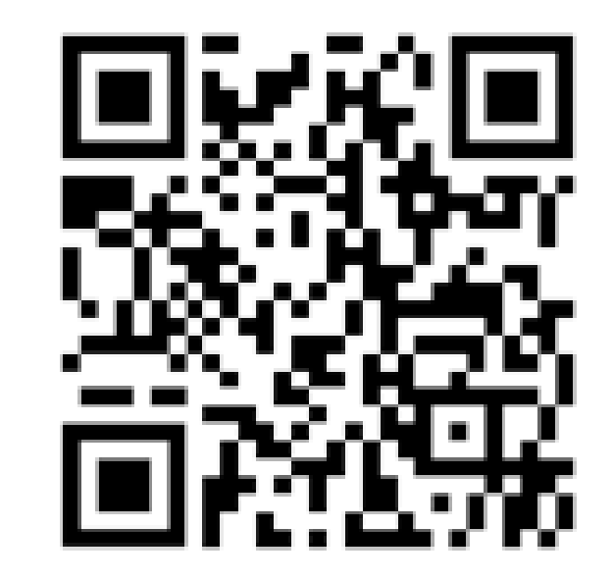
Networking Opportunities
STS Data Managers Facebook Group
At last check up to 388 Members!
STS Data Manager Collaborative
Formerly the Data Manager Mentorship Program, pairs data managers who are seeking advise related to data abstraction.
STS Regional Groups
Offers a collaborative networking environment for peer-to-peer support and non-clinical guidance related to abstraction across specific regions.
Notes:
Adie Dolan DMC Colab; Judy Smith leads RG-More to come about RGs on the March Monthly Webinar

Slide 4
AQO 2025
Notes:
2 dayCHSD and GTSD on Thur 10/2 ACSD on Fri 10/3

Slide 5
February
Note:
You can print this template to use as a wall calendar. You can also copy the slide for any month to add to your own presentation.
The February Training Manual has been updated.
Groundhog Day
ACSD Monthly Webinar 2pm CT
Harvest 4 2024 Reports Available
Valentine’s Day
Presidents’ Day
ACSD QI Series Webinar
2pm CT
Harvest 1
Close
1:59pm ET
Opt-Out Date
Session 1: ACSD
DM Training 12pm CT
Session 2: ACSD
DM Training 12pm CT
ACSD Monthly Webinar 2pm CT

Slide 6
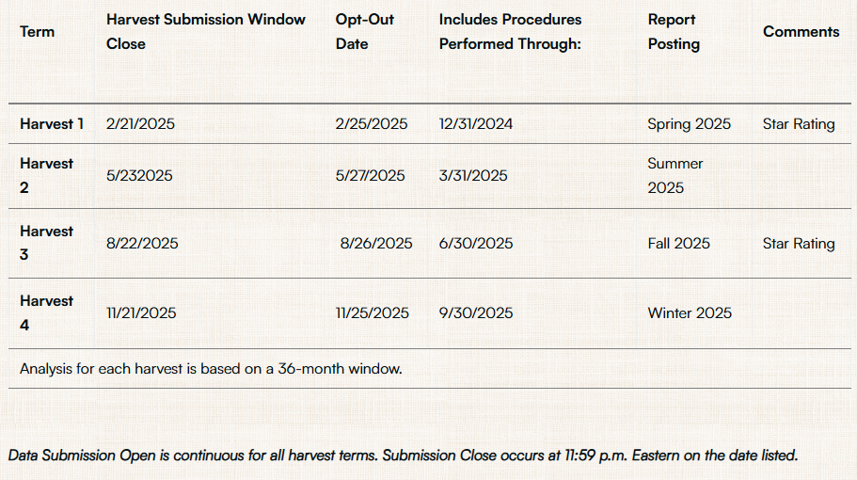
Harvest Dates 2025

Slide 7
Harvest 1 2025
Surgery dates include cases from January 1, 2022 - December 31, 2024
Star Rating Harvest
Includes the Multiprocedural surgery category (replaces ALL) and includes MultiValve and MultiValve + CABG

Slide 8
Harvest 1 2025
Submit early and often!
Data clean-up is the key to a successful harvest
Check for missingness
Check for missing variables
Check warnings and critical errors

Slide 9
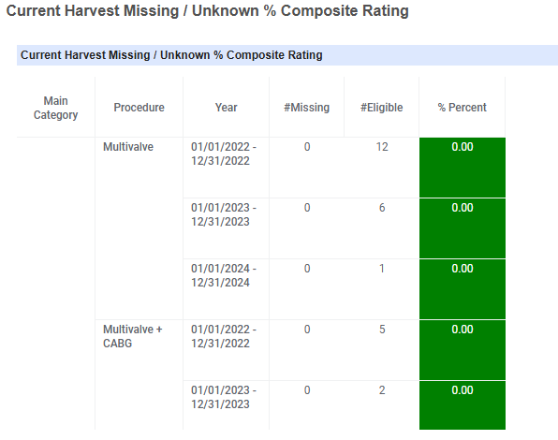
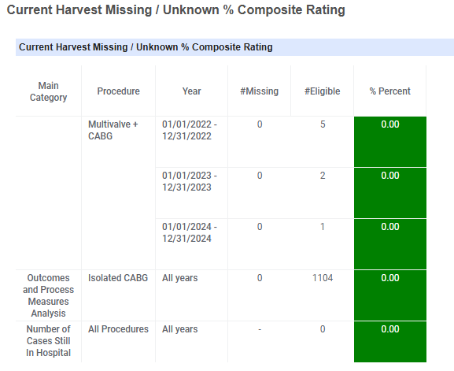
Check for Missingness
Notes:
IQVIA platform Community page, scroll down

Slide 10
Missing Variable Summary

Slide 11
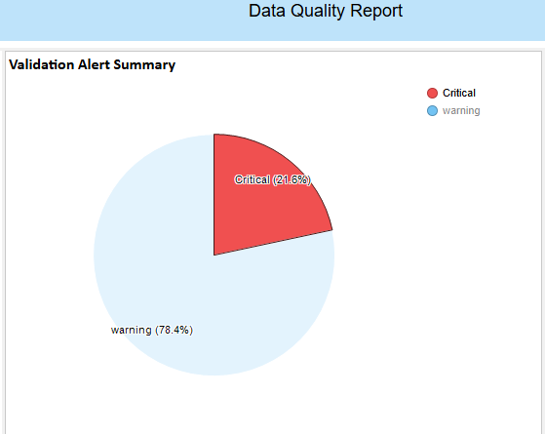
Data Quality Report
Notes:
Warnings are usually values that are out of range, critical warnings are things that prevent your file from being accepted and must be addressed NPI mismatch, age. You will get a hyperlink that will help you identify the case and drilldown so that you can update the errors.

Slide 12
Harvest Summary Report

Slide 13
Thresholds for Star Ratings
National Report Overview found in IQVIA Library
Must have less than 2% missing/unknown for mortality fields
Must have less than 5% missing medications (CABG only)
Must have submitted new data within the most recent quarter (H2/H4) or most recent 2 quarters (H1/H3)
Minimum Data Thresholds by Procedure ID
CABG | 50
AVR/AVR + CABG | 10
MVRR | 36
MVRR + CABG | 25
MultiValve/MultiValve + CABG | No minimum data thresholds
Multiprocedural | 100 across all procedure IDs

Slide 14
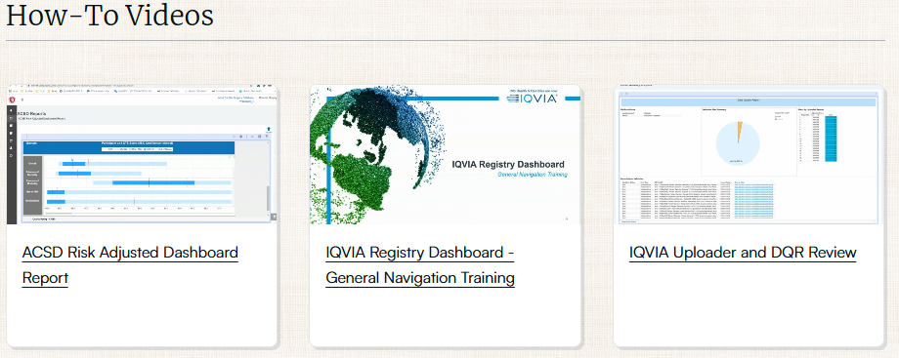
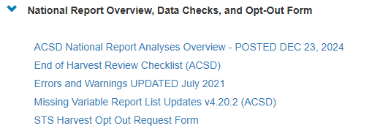
Resources
STS Website
IQVIA Library
Notes:
Ex Errors and Warnings

Slide 15
Exceptional Risk Exclusion
We have had 100 cases submitted since the introduction of the initiative in June 2024.
36 were declined prior to review; 7 excluded from analysis (not including cases that are currently under review)
Reminders:
Only isolated cases
Submit prior to surgery
Submit cases that are NOT adequately captured by risk model
Remember to redact records-all PHI, surgeon staff and hospital identifiers
Decisions are made prior to analysis

Slide 16
Red Cap for Valve Implants
For valve implants that are not included in the 4.20 DCF
Currently undergoing a mapping project in order to add new implants to the dropdown list
Please check the data specs to make sure that the valve you are entering is indeed not in the valve drop down within the database
NO aortic grafts unless you are entering a valved conduit
To help with mapping for future upgrades to the Red Cap form for valve implants, please provide as much information as possible including:
model number
name of device
manufacturer
FYI-some manufacturers have changed St. Jude Medical < Abbott, Sorin/Liva Nova < Corcym
Notes:
Refer to the data specs for valves on the 4.20 list. Google is your friend for model numbers.

Slide 17
Reports
Reminders:
Comparing risk adjusted and non-analyzed is like comparing apples to oranges-not going to match up.
Star rating harvest reports are static. They are a snapshot of the data on the date of harvest close at 11:59pm ET.
Non-analyzed reports (Participant Dashboard) are dynamic and update every time you submit data.

Slide 18
QI Series
Our next quality webinar is February 19th
We will present the national data around blood usage
April-Dr. Karen Singh University of Virginia
We need presenters and we want to hear from YOU!

Slide 19
New for 2025…
Data Manager Training Webinars!
Formerly known as New Data Manager Webinars
Open to All Data Managers
Starting Tuesday, February 25, 2025, 12 pm CT
Data Manager Training Webinar Agenda
Session 1 | Overview STS Website, FAQ Mailbox, Training Manual and Other Resources
Session 2 | Overview of Data Specifications, Software Specifications, Risk Model
Session 3 | Case Inclusion and Choosing the Index Procedure, PROC ID Chart
Session 4 | Harvesting your Data and the Data Quality Report
Session 5 | National Report Overview and Process / Outcome Measures
Session 6 | IQVIA Reporting Overview
Session 7 | Updating Participant Forms, STS Helpdesk, and Red Cap Forms

Slide 20
Resources
STS National Database Webpage
STSDB_Helpdesk@sts.org (Uploader, DQR, Missing Variable, Dashboard, Password and Login )
STS-FAQ@sts.org
STS National Database Feedback Form
Resource Documents
Contact Information
Webinar Information
FAQ Document
Go-Live Checklist
Tiered-level Support Document
Training Videos
Link to IQVIA
ckrohn@sts.org
nhoneycutt@sts.org

Slide 21
This Photo by Unknown Author is licensed under CC BY-NC-ND

Slide 22
Open Discussion
Please use the Q&A Function.
We will answer as many questions as possible.
We encourage your feedback and want to hear from you!
Please use the raise-hand function.

