Slide 1
Society of Thoracic Surgeons Congenital Heart Surgery Database Monthly Webinar
October 17, 2023

Slide 2
Agenda
Welcome and Introduction
STS Update
STS Data Manager Education (Chasity Wellnitz and Leslie Wacker, CHSD Consultants)
Q&A

Slide 3
STS Updates
6.23.2 October Training Manual is posted
Fall 2023 Harvest: Includes Surgery dates 7/1/2019 -6/30/2023
Harvest Closed September 15th @ 11:59pmET
Analysis Report Results available in coming weeks
Spring 23 Harvest: Includes Surgery dates 1/1/2020 – 12/31/2023
Official harvest close date coming soon!
CHSD Public Reporting last updated in September – Email notification sent 9/10/23

Slide 4
Thank you for attending AQO 2023
All recorded content is available for viewing within the meeting platform
Click on presentation you wish to view; click “Join Session”
Q&A is available to watch after the presentation
Content will be moved over to STS Education within the next week
If you did not register for AQO, you will be able to purchase virtual content
Deadline to complete all evaluations and claim education credit is Friday, December 29, 2023
AQO Hot Topics webinar coming in December – details coming soon!
Back to in person meeting for 2024

Slide 5
Data Manager Education
October 17, 2023

Slide 6
Discussion Topics
Back to Basics
Updates

Slide 8
Back to Basics
Case inclusion
Glossary
Timelines
Harvest
Analysis

Slide 9
Case Inclusion
General Rule: EVERY case done by a congenital surgeon on your Schedule A
Requirement: EVERY cardiac case done by a congenital surgeon on your Schedule A
Every field, every time

Slide 10
Case Inclusion, continued
What’s different with adult cases (v6.23)?
General Rule: If you would have included them in v3.41, include them now
Ideally: Every congenital patient having surgery at your site (with your surgeon group)
BE CONSISTENT AT YOUR SITE

Slide 11
Glossary
Schedule A: Contractual list of all participating surgeons for your Participant ID
“Cardiac” cases: Cases with an Operation Type 1 or 2
- CPB Cardiovascular (OpType 1)
- No CPB, Cardiovascular (OpType 2)
Episode of Care (EOC): The time period a patient is admitted preceding and/or following an operation through Database Discharge date (DB d/c)
Index operation: The first “cardiac” case of the Episode of Care
Primary procedure: The procedure with the highest STAT Mortality score of an operation considering all Rules & Exceptions

Slide 12
Glossary
Episode of Care (EOC): The time period a patient is admitted preceding and/or following an operation through Database Discharge date (DB d/c)

Slide 13
Glossary
Episode of Care (EOC): The time period a patient is admitted preceding and/or following an operation through Database Discharge date (DB d/c)
Admit for Norwood
(birth to POD 30)

Slide 14
Glossary
Episode of Care (EOC): The time period a patient is admitted preceding and/or following an operation through Database Discharge date (DB d/c)
D/C to OSH until POD 190
Admit for Norwood
(birth to POD 30)

Slide 15
Glossary
Episode of Care (EOC): The time period a patient is admitted preceding and/or following an operation through Database Discharge date (DB d/c)
D/C to OSH until POD 190
Admit for Norwood
(birth to POD 30)
Admit for Glenn
POD 190 to 210

Slide 16
Glossary
Episode of Care (EOC): The time period a patient is admitted preceding and/or following an operation through Database Discharge date (DB d/c)
D/C to OSH until POD 190
D/C to OSH POD 210 to 225
Admit for Norwood
(birth to POD 30)
Admit for Glenn
POD 190 to 210

Slide 17
Glossary
Episode of Care (EOC): The time period a patient is admitted preceding and/or following an operation through Database Discharge date (DB d/c)
D/C to OSH until POD 190
D/C to OSH POD 210 to 225
Admit for Norwood
(birth to POD 30)
Admit for Glenn
POD 190 to 210
Readmit for observation
POD 225

Slide 18
Glossary
Episode of Care (EOC): The time period a patient is admitted preceding and/or following an operation through Database Discharge date (DB d/c)
D/C to OSH until POD 190
D/C to OSH POD 210 to 225
D/C to home
Admit for Norwood
(birth to POD 30)
Admit for Glenn
POD 190 to 210
Readmit for observation
POD 225

Slide 19
Glossary
Episode of Care (EOC): The time period a patient is admitted preceding and/or following an operation through Database Discharge date (DB d/c)
D/C to OSH until POD 190
D/C to OSH POD 210 to 225
D/C to home
Admit for Norwood
(birth to POD 30)
Admit for Glenn
POD 190 to 210
Readmit for observation
POD 225
Same Database Discharge date =
Same Episode of Care (EOC)

Slide 20
Glossary
EPISODE OF CARE
Episode of Care (EOC): The time period a patient is admitted preceding and/or following an operation through Database Discharge date (DB d/c)
D/C to OSH
POD 190
D/C to OSH
POD 210-225
D/C to home
POD 240
Admit for Norwood
birth to POD 30
Admit for Glenn
POD 190-210
Readmit for observation
POD 225
Same Database Discharge date =
Same Episode of Care (EOC)

Slide 21
Glossary
Index operation: The first “cardiac” case of the Episode of Care

Slide 22
Glossary
Index operation: The first “cardiac” case of the Episode of Care, regardless of the sequence of operations

Slide 23
Glossary
Index operation: The first “cardiac” case of the Episode of Care, regardless of the sequence of operations
ECMO cannulation

Slide 24
Glossary
Index operation: The first “cardiac” case of the Episode of Care, regardless of the sequence of operations
ECMO cannulation
ECMO decannulation, VAD insertion

Slide 25
Glossary
Index operation: The first “cardiac” case of the Episode of Care, regardless of the sequence of operations
ECMO cannulation
ECMO decannulation, VAD insertion
VAD procedure

Slide 26
Glossary
Index operation: The first “cardiac” case of the Episode of Care, regardless of the sequence of operations
ECMO cannulation
ECMO decannulation, VAD insertion
VAD procedure
VAD procedure

Slide 27
Glossary
Index operation: The first “cardiac” case of the Episode of Care, regardless of the sequence of operations
ECMO cannulation
ECMO decannulation, VAD insertion
VAD procedure
VAD procedure
Heart transplant, VAD explant

Slide 28
Glossary
Index operation: The first “cardiac” case of the Episode of Care, regardless of the sequence of operations
ECMO cannulation
ECMO decannulation, VAD insertion
VAD procedure
VAD procedure
Heart transplant, VAD explant
OpType ECMO
OpType VAD
OpType VAD
OpType CPB, Cardiovascular
OpType VAD

Slide 29
Glossary
Index operation: The first “cardiac” case of the Episode of Care, regardless of the sequence of operations
ECMO cannulation
ECMO decannulation, VAD insertion
VAD procedure
VAD procedure
Heart transplant, VAD explant
OpType ECMO
OpType VAD
OpType VAD
OpType CPB, Cardiovascular
OpType VAD

Slide 30
Glossary
Primary procedure: The procedure with the highest STAT Mortality score of an operation considering all Rules & Exceptions
(870) – Norwood Procedure
(3680) – RV to PA Shunt (e.g. Sano Shunt or palliative RV-PA non-valved conduit to augment pulmonary blood flow)
(1330) – PDA closure, Surgical

Slide 31
Glossary
(870) – Norwood Procedure
(3680) – RV to PA Shunt (e.g. Sano Shunt or palliative RV-PA non-valved conduit to augment pulmonary blood flow)
(1330) – PDA closure, Surgical

Slide 32
Glossary

Slide 33
Glossary

Slide 34
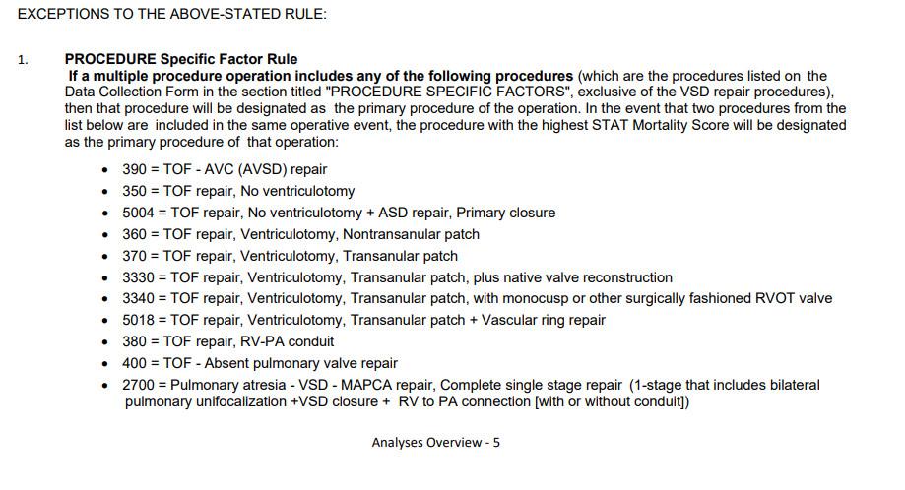
Glossary

Slide 35
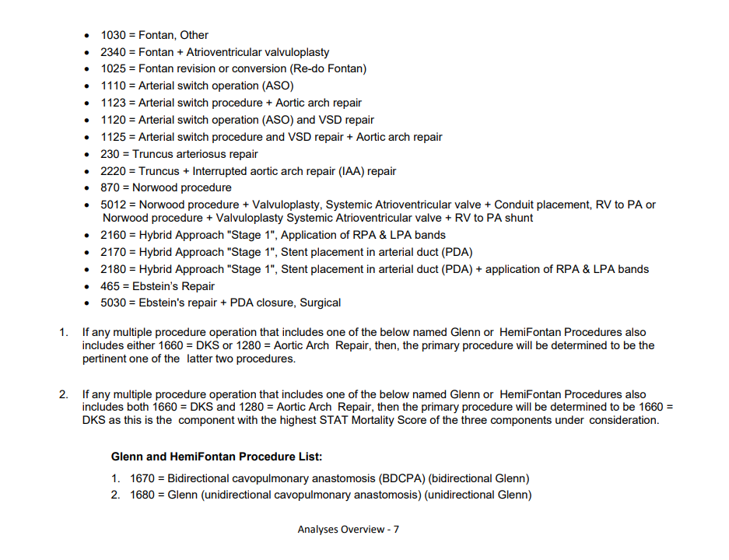
Glossary

Slide 36
Glossary
Primary procedure: The procedure with the highest STAT Mortality score of an operation considering all Rules & Exceptions
(870) – Norwood Procedure
(3680) – RV to PA Shunt (e.g. Sano Shunt or palliative RV-PA non-valved conduit to augment pulmonary blood flow)
(1330) – PDA closure, Surgical

Slide 37
Glossary, continued
Training Manual (TM): aka definitions, data dictionary – document of all definitions and coding guidelines
Analysis Overview: Explanation of how analysis was performed (combination codes, Primary Procedure rules and exceptions, inclusion/exclusion criteria)
Appendix C: List of all procedures with STAT Mortality Score and Category
Data Collection Form (DCF): Document with all fields for an individual case

Slide 38
Timelines
Harvest Period – Rolling 4 year analytical window
Calendar Year (Jan – Dec)
Fiscal Year (July – June)
Harvest Inclusion – All operations with a surgery date within the harvest period
Version – Typically 3-4 years
Other – STAT scores, combination procedures

Slide 39
Harvest
Create harvest file (software specific)

Slide 40
Harvest
Create harvest file (software specific)
Upload to IQVIA
Clean data
Resubmit up until Harvest deadline

Slide 41
Harvest
Create harvest file (software specific)
Upload to IQVIA
Clean data
Resubmit up until Harvest deadline
Snapshot taken of Harvest window

Slide 42
Harvest
Create harvest file (software specific)
Upload to IQVIA
Clean data
Resubmit up until Harvest deadline
Snapshot taken of Harvest window
Analysis begins

Slide 43
Harvest
Create harvest file (software specific)
Upload to IQVIA
Clean data
Resubmit up until Harvest deadline
Snapshot taken of Harvest window
Analysis begins
Report publication

Slide 44
Analysis
File comes in

Slide 45
Analysis
File comes in
Filter down to primary procedure

Slide 46
Analysis
File comes in
Filter down to primary procedure
Determine index operation

Slide 47
Analysis
File comes in
Filter down to primary procedure
Determine index operation
Apply inclusion/exclusion criteria (Analysis Overview)

Slide 48
Analysis
File comes in
Filter down to primary procedure
Determine index operation
Apply inclusion/exclusion criteria (Analysis Overview)
Analyzed report

Slide 49
Updates
TM and FAQ summary is posted for October
**Follow-Up date (Last Known Follow Up Date) MUST be on or after the date of surgery to submit cases to IQVIA**

Slide 50
In Summary
Available for help always!

Slide 51
Open Discussion
Please use the Q&A Function.
We will answer as many questions as possible.
We encourage your feedback and want to hear from you!

Slide 52
Upcoming CHSD Webinars
User Group Call
November 7 @ 12pm CT
Monthly Webinar
November 21 @ 12pm CT
Notes:
New Data Manager webinar – Leslie doing demo of harvest tools (MVR, Harvest Summary Report, Prim Procedure Mismatch, etc.)

Slide 53
Contact Information
Leigh Ann Jones, STS National Database Manager, Congenital and General Thoracic
Ljones@sts.org
Tech Support
Analysis Report/Data Submission Questions
STSDB@sts.org
STSDB_helpdesk@sts.org
Database Operational Questions
Congenital STS Database Consultants
Leslie Wacker lwacker@sts.org
Chasity Wellnitz cwellnitz@sts.org
This Photo by Unknown author is licensed under CC BY-SA.

Slide 54
THANK YOU FOR JOINING!

