Slide 1
Society of Thoracic Surgeons General Thoracic Surgery Database Monthly Webinar
October 11, 2023

Slide 2
Agenda
Welcome and Introduction
STS Updates
Temporary Fields Update
Education (Ruth Raleigh, GTSD Consultant)
Q&A

Slide 3
STS Updates
October Training Manual to be posted by end of week
GTSD Public Reporting
Next update scheduled for Winter 2023 and will reflect 2023 Fall Harvest results
Spring 24 Harvest is underway
Surgery dates 1/1/2021 – 12/31/2023
Official harvest close date coming soon!

Slide 4
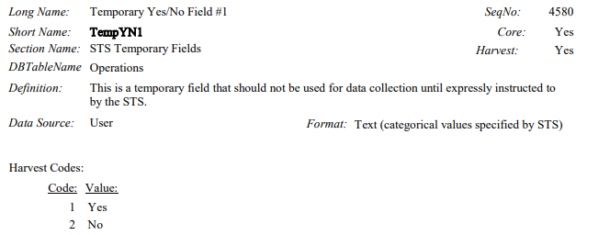
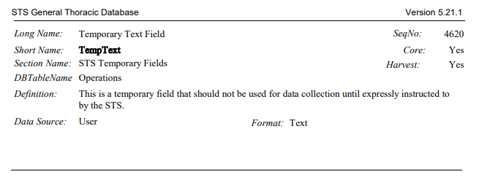
STS Updates
Activating two of the STS Temporary Fields – October 2023
Seq. 4580 - TempYN1
Seq. 4620 – TempText
STS will send formal communication to all GTSD Participants and Vendors
IF you are currently using these two fields STOP!

Slide 5
STS Updates
Why are we activating these two fields?
TempY/N1 (Seq. 4580) : Did the patient receive induction immunotherapy or a targeted agent directed at the lung cancer of interest?
TempText (Seq.4620): If so, what agent?

Slide 6
Thank you for attending AQO 2023
All recorded content is available for viewing
Click on presentation you wish to view; click “Join Session”
Q&A is available to watch after the presentation
Deadline to complete all evaluations and claim education credit is Friday, December 29, 2023
AQO Hot Topics webinar coming in December – details coming soon!
Back to in person meeting for 2024

Slide 7
STS Education Ruth Raleigh (GTSD Consultant)

Slide 8
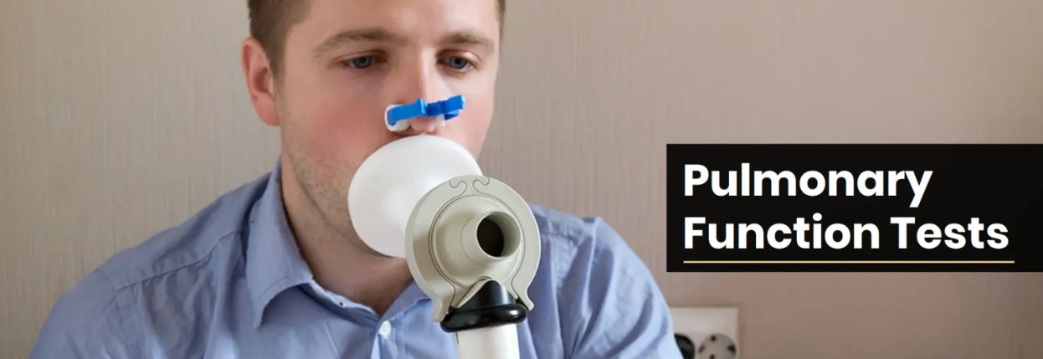
PFT Q & A

Slide 9
Time Frame

Slide 10
Seq 750: FEV 1 % Predicted
87
86
81
55

Slide 11
Seq 750: FEV 1 % Predicted

Slide 12
Seq 781: DLCO Predicted Low
91
102
89

Slide 13
Seq 781: DLCO Predicted Low

Slide 14
Seq 750: FEV 1 % Predicted
124
79
110
82

Slide 15
Seq 781: DLCO Predicted Low
5.05
92
99
18.79

Slide 16
Seq 750: FEV 1 % Predicted
114
91
98
104

Slide 17
Calculating FEV1
(Actual (L)/Predicted(L))x100=%predicted
1.92/1.84= 1.0434782 x 100 = 104.347%
The training manual indicates to round to the nearest whole number for entry. Round down any decimal less than .5, round up .5 or greater.
***Note this does not equal 91% +14%

Slide 18
Seq 781: DLCO Predicted Low
104
107
103

Slide 19
Upcoming GTSD Webinars
New Data Manager Webinar
October 25 @ 2pmCT
Monthly Webinar
November 8 @ 1:30CT

Slide 20
Open Discussion
Please use the Q&A Function.
We will answer as many questions as possible.
We encourage your feedback and want to hear from you!

Slide 21
Contact Information
Leigh Ann Jones, STS National Database Manager, Congenital and General Thoracic
Ljones@sts.org
312-202-5822
Helpdesk Support
(Harvest Questions/Analysis Report Questions)
STSDB_helpdesk@sts.org
Database Operational Questions
(Database Participation, Contracts, etc.)
STSDB@sts.org
This Photo by Unknown author is licensed under CC BY-SA.

Slide 22
THANK YOU FOR JOINING!

