Slide 1
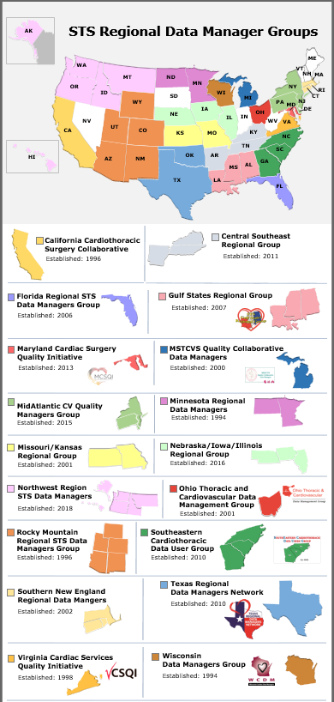
STS Regional Data Manager Groups
Year Established | STS Regional Data Manager Groups As of October 2023: 16 Regions/38 States
1994 | Minnesota/Eastern North Dakota Wisconsin
1996 | California Rocky Mountain Region (AZ, CO, NM, UT, WY)
1998 | Virginia
2000 | Michigan
2002 | Ohio Southern New England Group (CT, MA, RI)
2003 | Kansas/Missouri (Regional Leader needed)
2006 | Florida Northwest Region (AK, HI, ID, MT, OR, WA)
2007 | Gulf States (AL, LA, MS)
2010 | Southeastern Region (GA, NC, SC) Texas (OK, TX)
2011 | Central Southeast Group (AR, KY, TN)
2013 | Maryland
2015 | MidAtlantic CV Quality Managers Group (DE, PA, NJ, NY)
2016 | Illinois/Iowa/Nebraska(Regional Leader needed)
Color Key
Red | Data Managers Only Need Surgeon Support
Blue | Data Managers Surgeons as Consultants Ad Hoc
Green | Regional Quality Collaboratives Joint DM and Surgeon Meetings
Black | Regional Leader Needed
States without Regional Activities Volunteer Today!
Illinois
Iowa
Kansas
Maine
Missouri
Nebraska
Nevada
New Hampshire
South Dakota
Vermont
West Virginia
Updated October 2023

